Slide 1

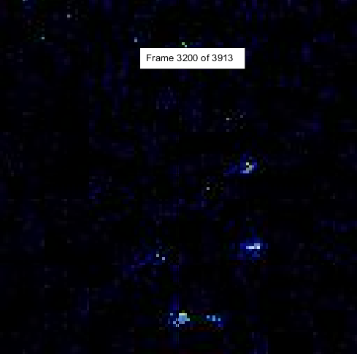
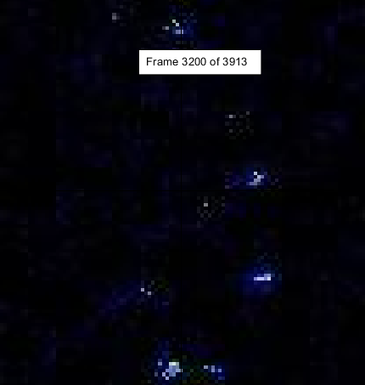
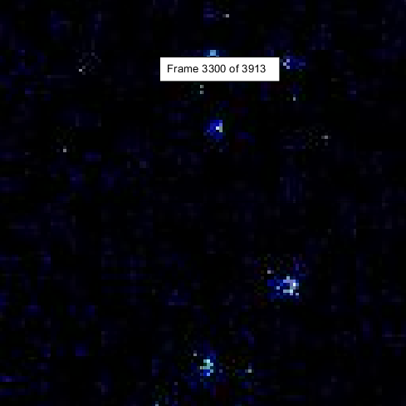
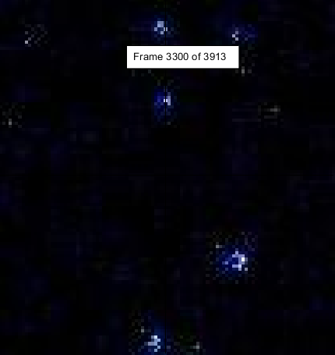
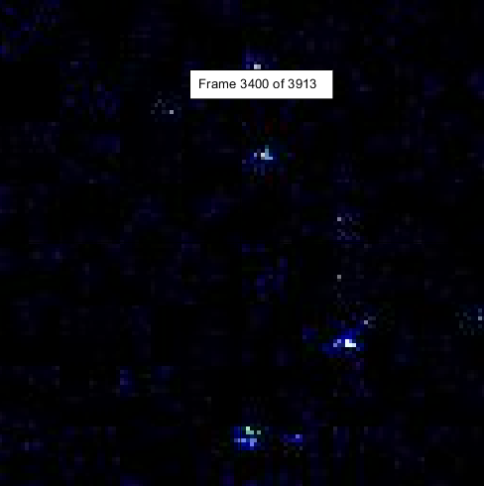
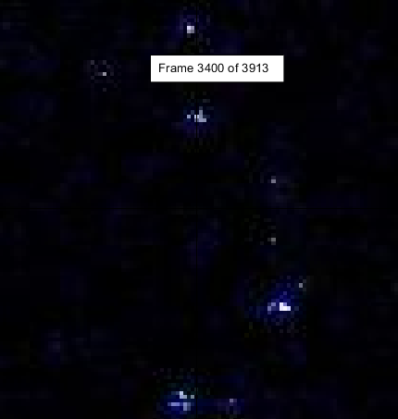
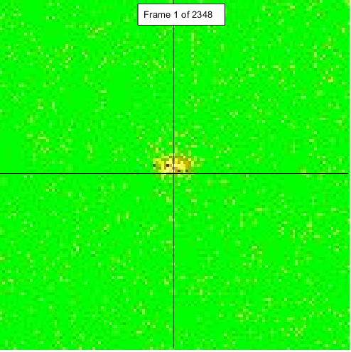
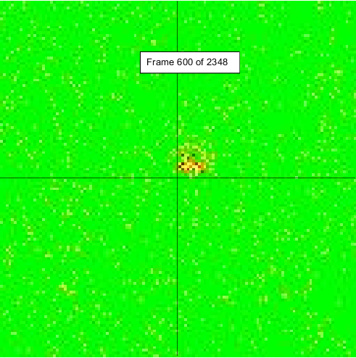
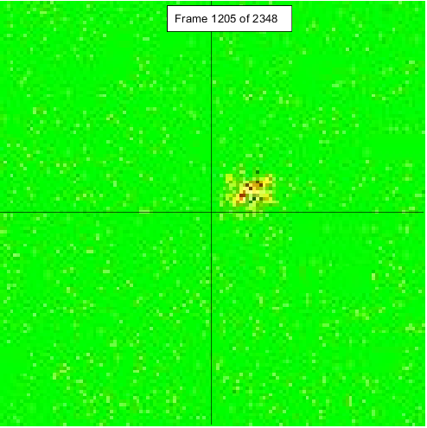
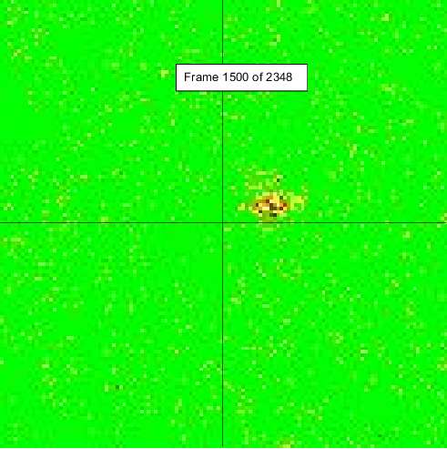
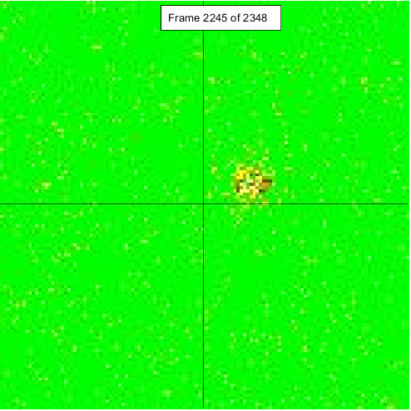
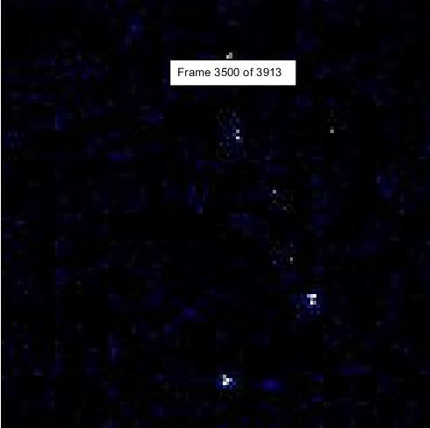
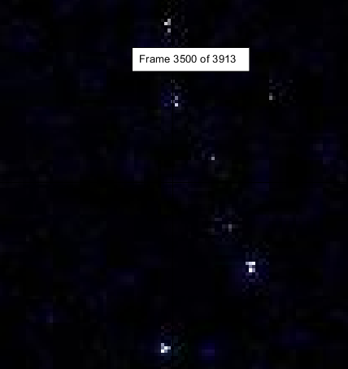
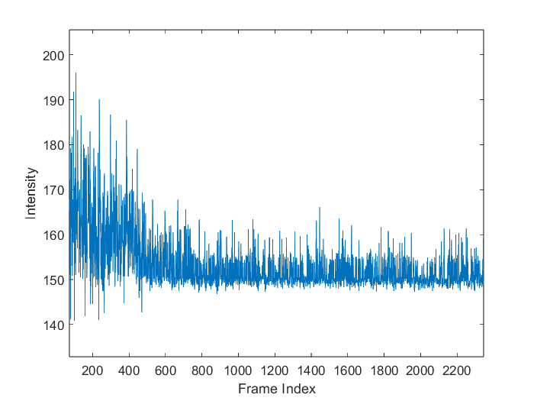
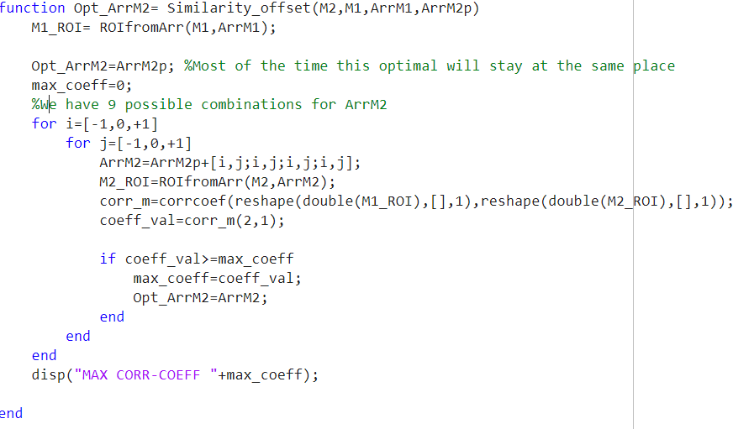
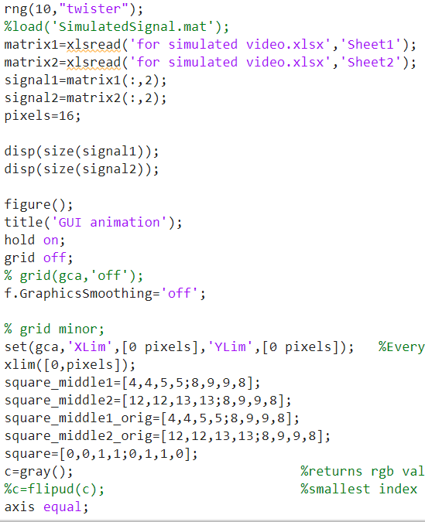
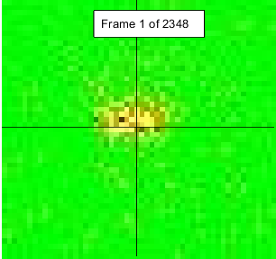
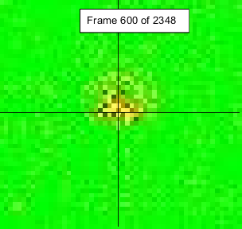
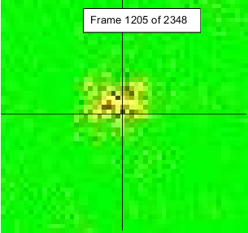
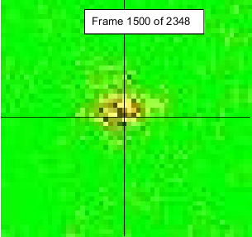
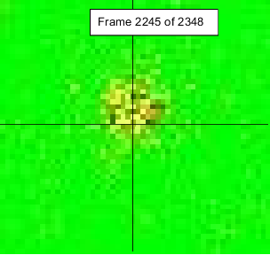
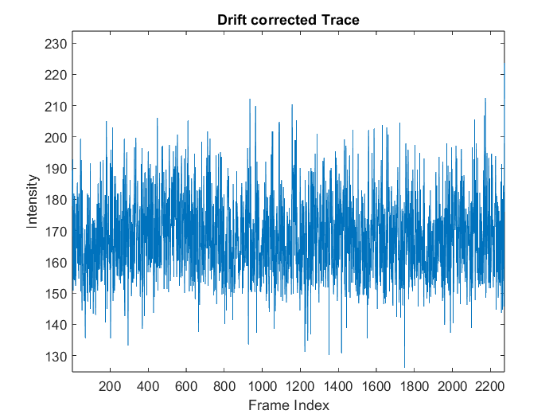
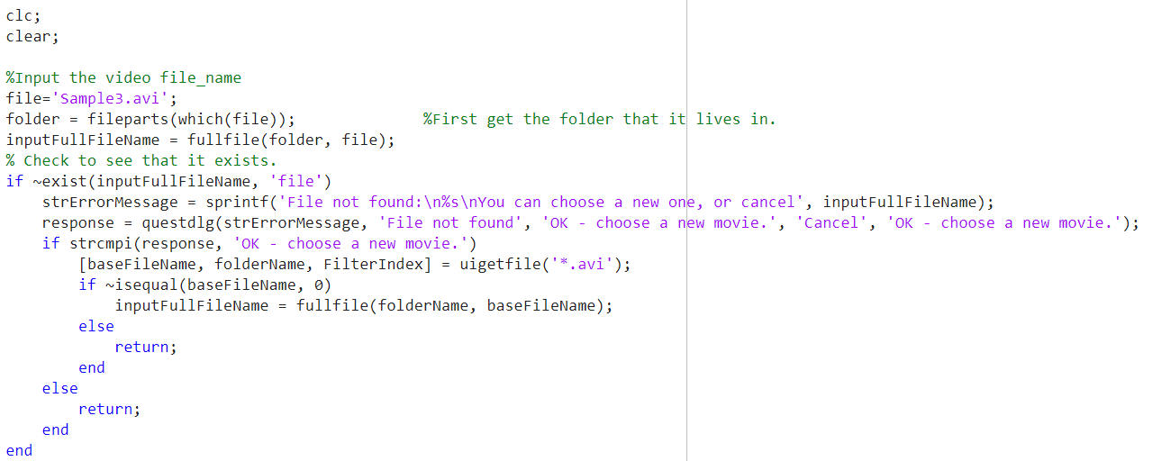
Analysis Program for Blinking Statistics of QDs in Matlab
Aditya Prasad, Department of Mechanical Engineering
Professor Saumyakanti Khatua, Department of Chemistry
Indian Institute of Technology Gandhinagar, Gujrat
Abstract and Introduction
Completed List of tasks
Quantum dots(QD) are the materials of the future. They have varied applications ranging from solar plates, QLED devices, microbiology.
Studying single particle photo luminescence blinking is of utmost importance towards improving their performance and limiting blinking.
Why Eliminate Drift in QD image traces?
Due to scanner inaccuracies, the QD images traces have a slight drift. This drift becomes significant over many frames.
This unwanted drift can cause hindrances in studying the blinking statistics.
GUI Animation with random induced drift
Drift Correction on GUI animation
Testing drift correction code on real video traces
Before Drift correction
After Drift correction
Results and Discussions
Input Trace (with drift)
The intensity at a point bleaches-out due to drift
Objectives and Schematic Diagrams
Learnings from the Project
Implementation drift correction algorithm
Output Trace (Without drift)
This was a wonderful opportunity for me to explore the emerging field of Quantum dot chemistry and about image processing.
I honed my Matlab coding skills through this project.
Similarity offset func
Work Flow
Drift GUI animation
Future scope of work
Testing and Debugging
The intensity varies according to QD blinking
A more optimized approach towards drift correction could be implemented.
A GUI interface for statistical analysis in an integrated environment.
I would like to express my sincere gratitude to Professor Saumyakanti and NVS Praneeth for their invaluable help and guidance to me.
Ref. Gedeborg & Li, M. (2010). Blinking Quantum Dots: Statistics through Image Processing (By Material Physics department of ICT schoolKTH)
https:// www.diva- portal.org/smash/get/diva2:470412/fulltext01.pdf

